Slide 1

Linux Lecture-1
www.corvit.com

Slide 2
Topics
What is an OS?
Computer System Organization
Multiprogramming vs Multitasking
User Mode & Kernel Mode
System Call, Interrupt, Trap & Signal
Processes
Threads
Scheduling Algorithms
Linux History
Pros & Cons
Distributions
Virtualization
www.corvit.com

Slide 3
What is an OS?
An OS is a program running at all times on the computer (usually called the kernel), that controls the execution of application programs and acts as an interface between the user of a computer and the computer hardware
Provides an orderly and controlled allocation of the processor(s), memory(ies) and I/O devices among the various programs competing for them.
Sits between programs & hardware
Sits between different programs
Sits between different users
Primary goal of OS is convenience of user and secondary goal is efficient operation of the computer system.
www.corvit.com

Slide 4
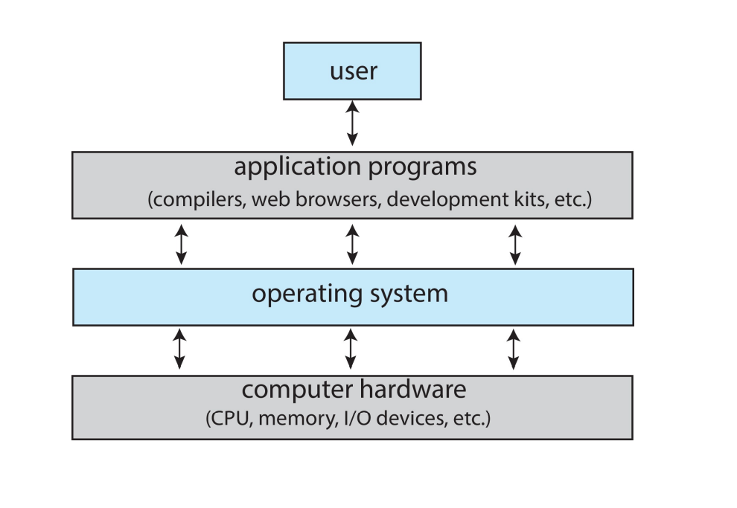
Operating System - An Abstraction
www.corvit.com

Slide 5
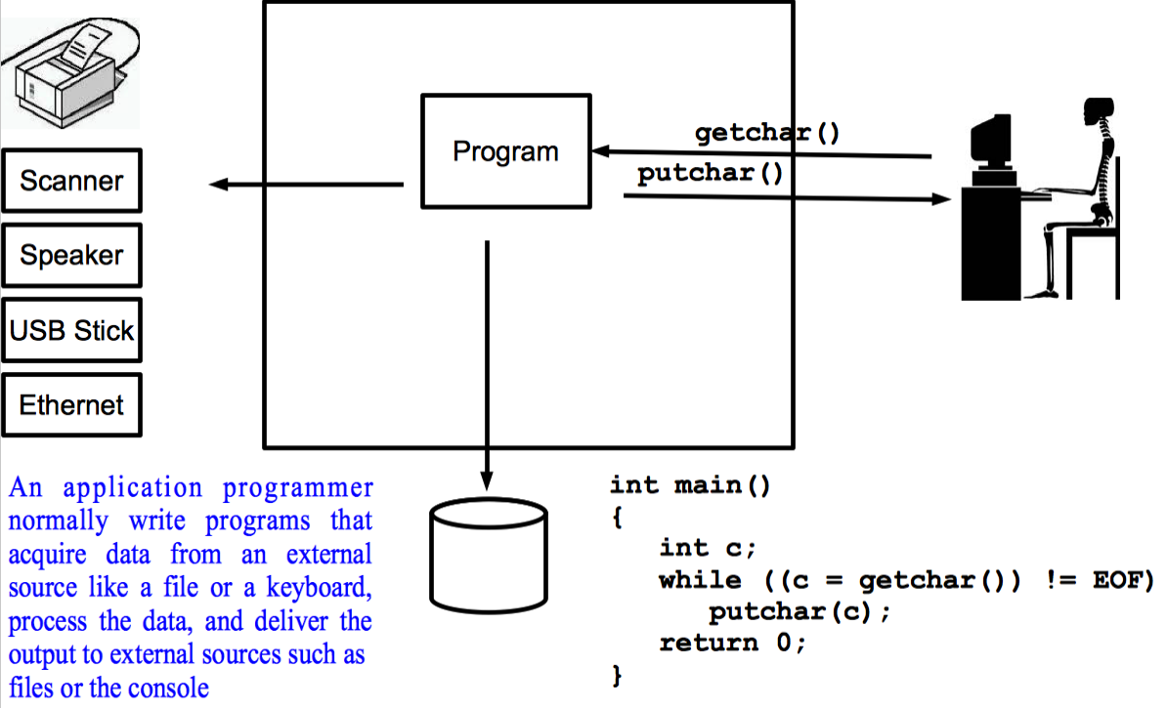
Operating System - An Abstraction
www.corvit.com

Slide 6
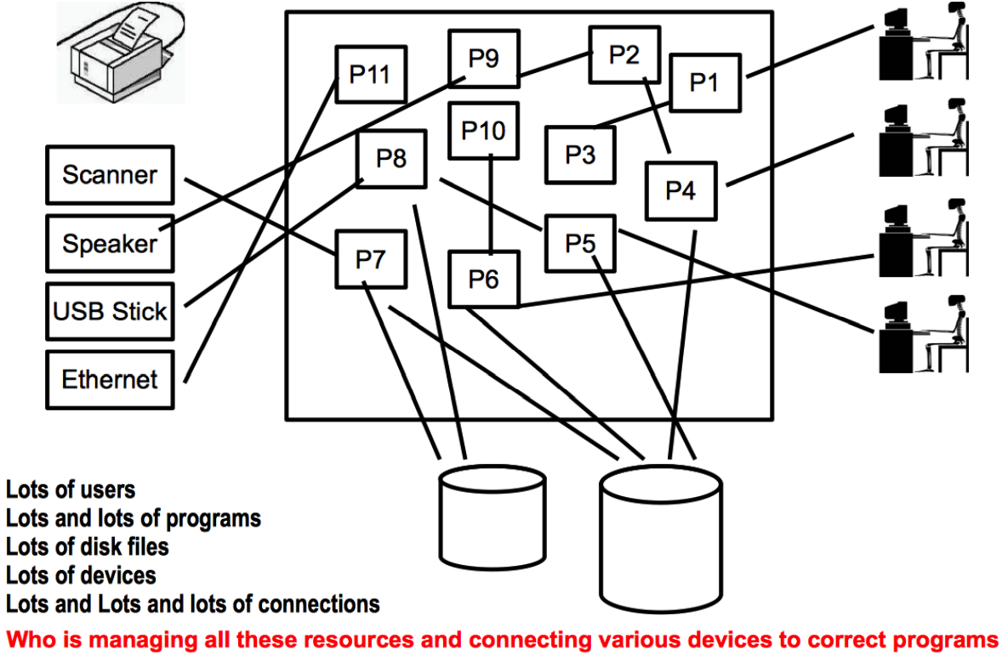
Operating System - An Abstraction
www.corvit.com

Slide 7
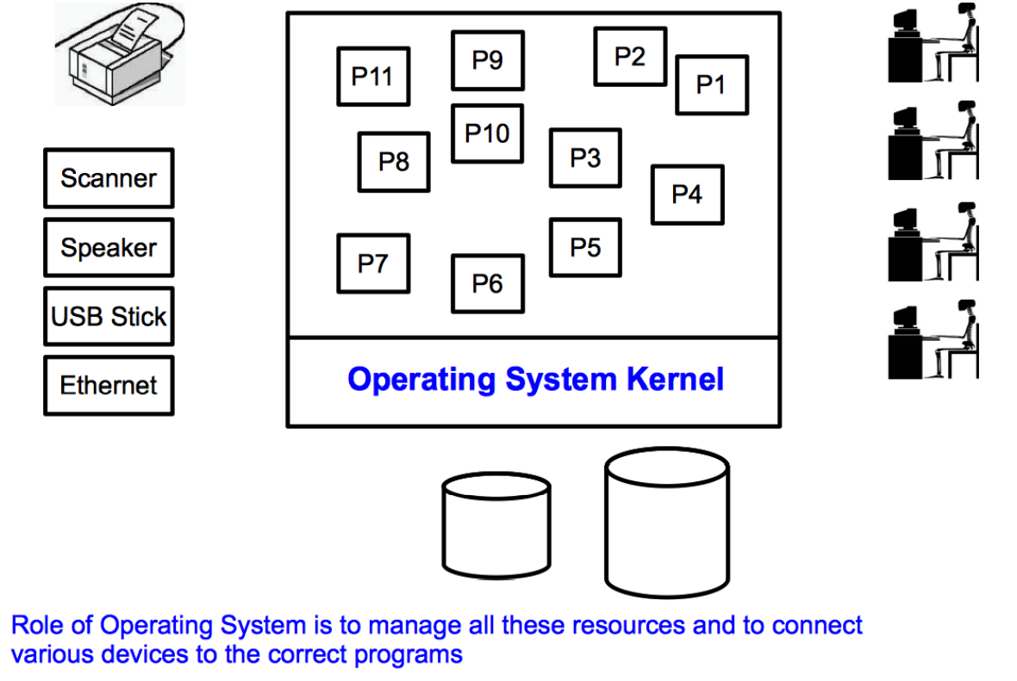
Operating System - An Abstraction
www.corvit.com

Slide 8
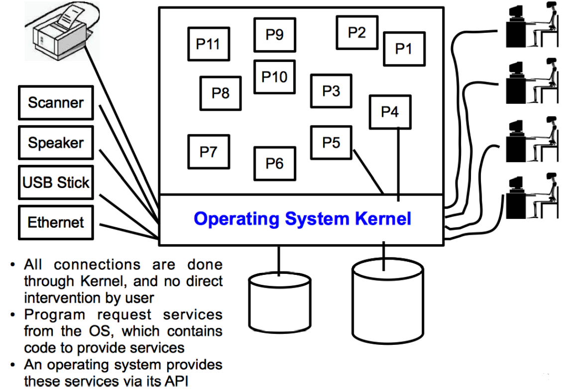
Operating System - An Abstraction
www.corvit.com

Slide 9
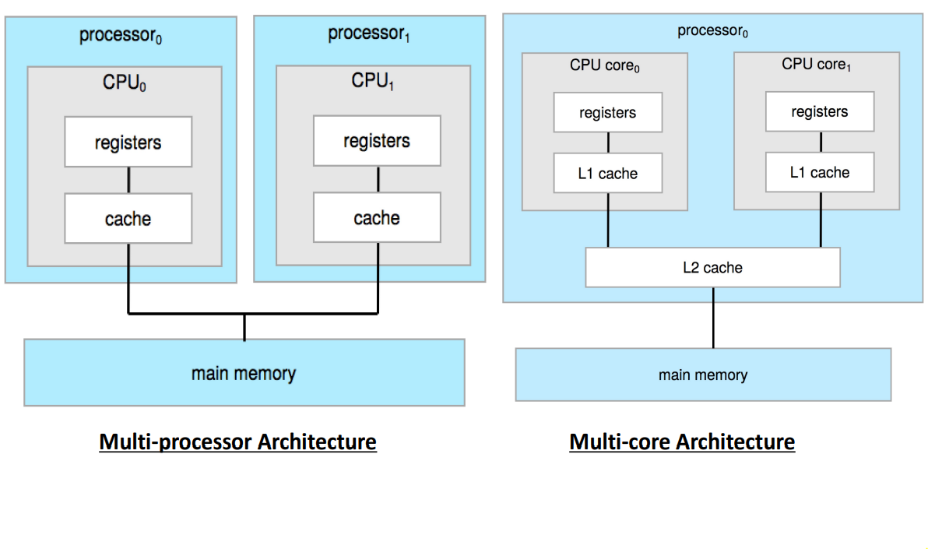
Computer System Organization
www.corvit.com

Slide 10
Multiprogramming vs Multitasking
Multiprogramming
Multitasking
Single user cannot keep CPU and I/O devices busy at all time
Multiprogramming organizes jobs so CPU always has one to execute
One job selected and run via job scheduling
When it has to wait (for I/O for example), OS switches to another job
CPU switches jobs so frequently that users can interact with each job while it is running, creating interactive computing
Each user has at least one process executing in memory
If several processes are ready to run at the same time, then OS performs CPU scheduling
If processes don’t fit in memory, swapping moves them in and out to run
www.corvit.com
Notes:
Multiprogramming:
Non pre-emptive
Definition: Running multiple programs on a single processor by managing how they share CPU time.
Goal: Maximize CPU utilization.
How it works: While one program is waiting for I/O (like reading from disk), the CPU is given to another program.
Example: A system running a compiler, a text editor, and a background printing task – switching between them when one is idle.
Used in: Older batch systems, simpler OS designs.
Multitasking/Time sharing:
Pre-emptive/ Time shring
Definition: Allows multiple tasks/processes to run seemingly simultaneously by rapidly switching between them.
Goal: Improve user interactivity, responsiveness
How it works: The OS switches between tasks very quickly using a time slice or quantum (e.g., every few milliseconds).
Example: Typing in a text editor while listening to music and downloading a file – all appear to happen at once.
Used in: Modern OSes (Windows, macOS, Linux, etc.).

Slide 11
Protection
In Multitasking there are multiple processes using various resources of the computer. Sounds great, but like no free lunch, it has disadvantage as well, i.e. the issue of protection
Keep user programs from crashing the OS
Keep user programs from crashing each other
Keep parts of OS from crashing other parts
Protection is implemented by keeping two modes
www.corvit.com

Slide 12
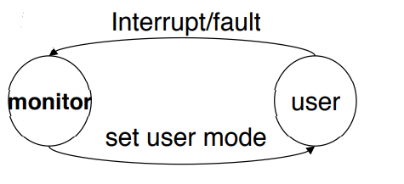
Dual Mode Operation
To protect the OS and all other programs and their data from any malfunctioning program, protection is needed for any shared resource. It is done by keeping two modes:
User Mode: Execution done on behalf of a user program
Monitor/Kernel/System/Supervisor Mode: Execution done on behalf of OS
Mode bit added to computer h/w to indicate the current mode: Kernel(0), User (1)
When an interrupt or fault occurs hardware switches to monitor mode. Privileged instructions can only be executed in monitor mode.
www.corvit.com
Notes:
By default, application runs in user mode and CPU switches between user mode and kernel mode.

Slide 13
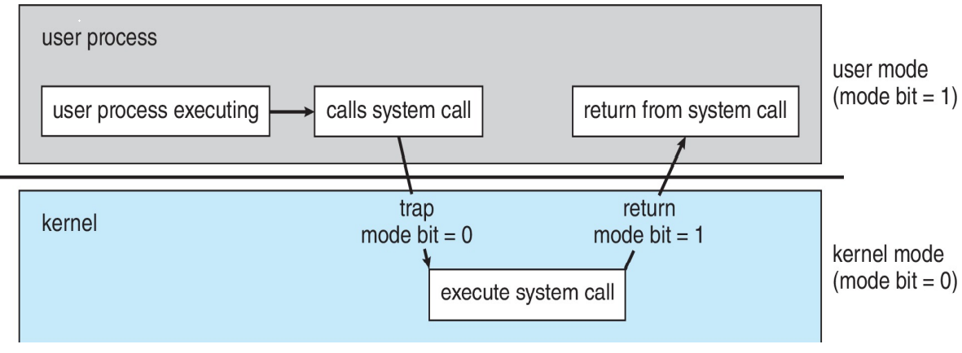
Transition from User to Kernel Mode
A user process must not be given an open access to kernel code
Any user/application request that involves access to any system resource must be handled by the kernel code
The mechanism used by an application program to request a service from Operating System is via a system call
A System call is usually a request to the OS kernel to do a h/w, system specific or privileged operation.
www.corvit.com

Slide 14
Types of Entry Points to Kernel
When a program makes a System Call.
Interrupt: An event generated by an I/O device to get the attention of CPU and control goes to the OS. When an I/O device has generated an Interrupt; e.g. a disk controller has generated an interrupt to CPU that my reading is complete the data is now sitting in my buffer, You can go and get it.
Trap: An event generated by CPU and control goes to the OS. When a trap occurs; e.g. If a program has made a division by zero, a trap will be generated which will execute a different piece of code in kernel (.
Signal: A notification given to a process by the OS because the process did something, the user did something, one process wants to tell another process something. When a signal comes to a process some piece of kernel code will be executed
www.corvit.com
Notes:
Interrupt: a signal that temporarily suspends the current task and directs the processor to handle a specific event, whether triggered by hardware or software, allowing for efficient multitasking and I/O operations
Trap:
Signal:

Slide 15
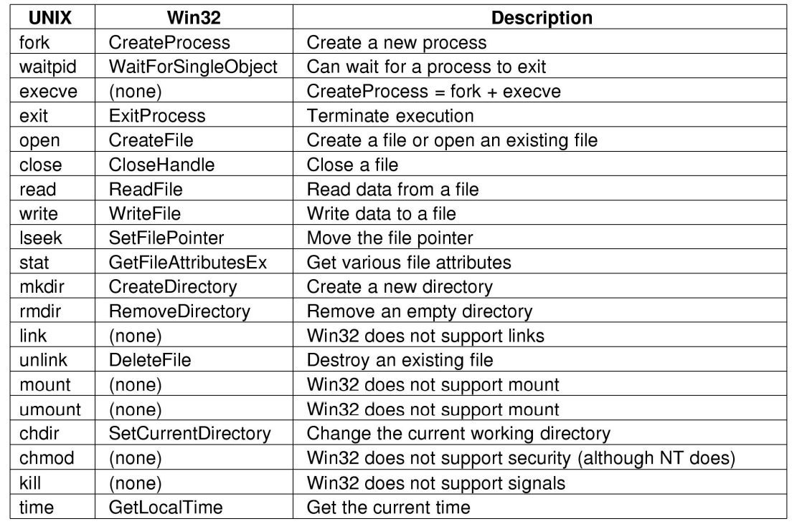
System Call
A system call is the controlled entry point into the kernel code, allowing a process to request the kernel to perform a privileged operation. Before going into the details of how a system call works, following points need to be understood:
A system call changes the processor state from user mode to kernel mode, so that the CPU can access protected kernel memory
The set of system calls is fixed. Each system call is identified by a unique number
Each system call may have a set of arguments that specify information to be transferred from user space to kernel space and vice versa
All OS’s offer their own System Calls
www.corvit.com

Slide 16
Users, Programs and Processes
Users have accounts on the system. Users write programs, then execute programs. Different users may execute same program. One user may execute many instances of the same program
A Program by itself is not a Process: Program is a passive entity like the contents of a file stored on a disk. Process is an active entity, in which the Program Counter specifies the next instruction to be executed
A Process is
A program in execution
An instance of a program running on a computer
An entity that can be assigned to and executed on a processor
The UNIX system creates a process every time you run an external command, and the process is removed from the system when the command finishes its execution
www.corvit.com

Slide 17


CPU Bound and I/O Bound Processes
I/O-bound process – spends more time doing I/O than computations; Many short CPU bursts
Examples: Word processing, text editors. Billing system of WAPDA which involves lot of printing.
CPU-bound process – spends more time doing computations; Few very long CPU bursts
Examples: Simulation of NW traffic involving lot of mathematical calculation, scientific applications involving matrix multiplication, DSP applications
www.corvit.com

Slide 18
5-State Process Model
Broadly speaking the life of a process consist of CPU burst and I/O burst but in reality
A process may be waiting for an event to occur; e.g. a process has created a child process and is waiting for it to return the result
A process may be waiting for a resource which is not available at this time
Process has gone to sleep for some time
So generally speaking a Process may be in one of the following five states:
new: The process is being created (Disk to Memory)
ready: The process is in main memory waiting to be assigned to a processor
running: Instructions are being executed
waiting: The process is waiting for some event to occur (I/O completion or reception of a signal)
terminated: The process has finished execution
www.corvit.com

Slide 19
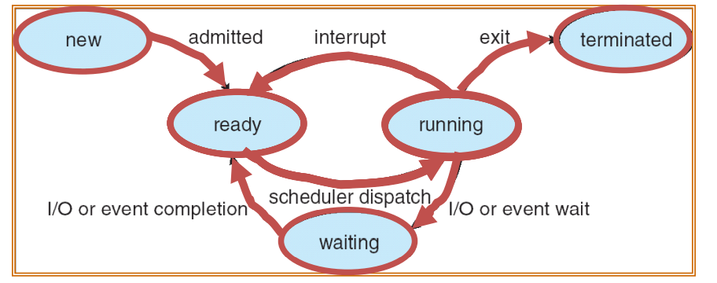
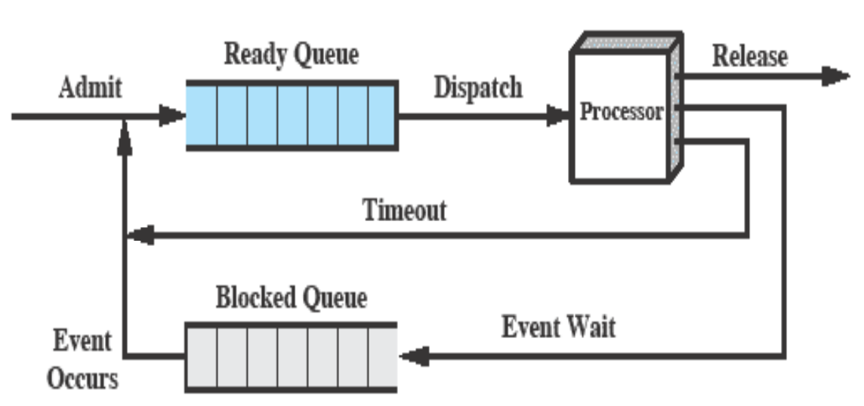
5-State Process Model
As a process executes, it changes state:
– new: The process is being created
– ready: The process is waiting to run
– running: Instructions are being executed
– waiting: Process waiting for some event to occur
– terminated: The process has finished execution
www.corvit.com

Slide 20
Process Scheduling Queues
Job Queue – When a process enters the system it is put into a job Queue. This queue consists of all processes in the system
Ready Queue – This queue consists of processes that are residing in main memory and are ready and waiting to execute. It is generally stored as a link list
Device Queues – When the process is allocated the CPU, it executes for a while and eventually quits as it may need an I/O. The list of processes waiting for a particular I/O device is called a device queue. Each device has its own device queue
A process in its life time will be migrating from one Q to another Q
www.corvit.com

Slide 21
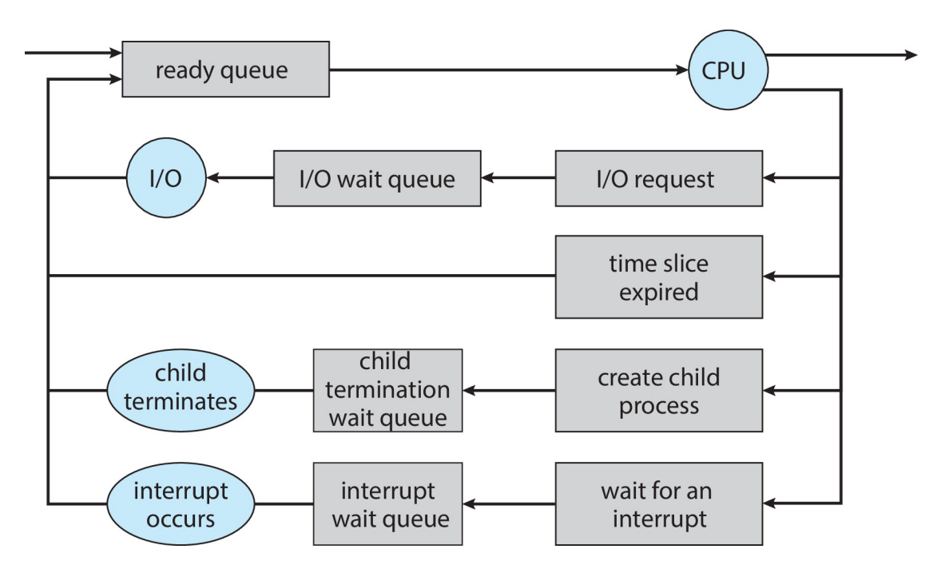
Queuing Diagram
www.corvit.com

Slide 22
Orphan vs Zombie Process
Orphan Process
Zombie Process
If a parent has terminated before reaping its child, and the child process is still running, then that child is called orphan
In UNIX all orphan processes are adopted by init or systemd which do the reaping
Zombie Process is a process that has terminated but its parent has not collected its exit status and has not reaped it. So a parent must reap its children
When a process terminates but still is holding system resources like PCB and various tables maintained by OS. It is half-alive & half-dead because it is holding resources like memory but it is never scheduled on the CPU
The only way to remove them from the system is to kill their parent, at which time they become orphan and adopted by inept or systemd
www.corvit.com
Notes:
The wait() system call is used for reaping and cleaning zombies from system, and serves two purposes Notify parent that a child process finished running Tell the parent how a child process finished The parent process calls the wait() system call and gets blocked till any one of its child terminates

Slide 23
Threads
Every process has two characteristics:
Resource ownership process includes a virtual address space to hold the process image
Scheduling follows an execution path that may be interleaved with other processes
These two characteristics are treated independently by the operating system. The unit of resource ownership is referred to as a process, while the unit of dispatching is referred to as a thread
A thread is an execution context that is independently scheduled, but shares a single addresses space with other threads of the same process
www.corvit.com
Notes:
Dispatcher is an important component involved in CPU scheduling The OS code that takes the CPU away from the current process and hands it over to the newly scheduled process is known as the dispatcher

Slide 24
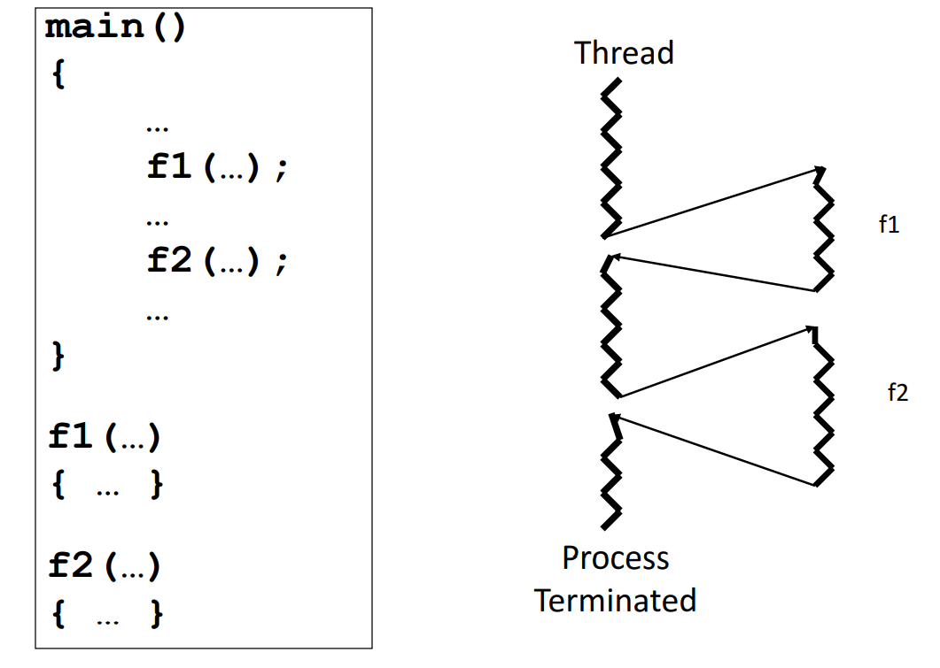
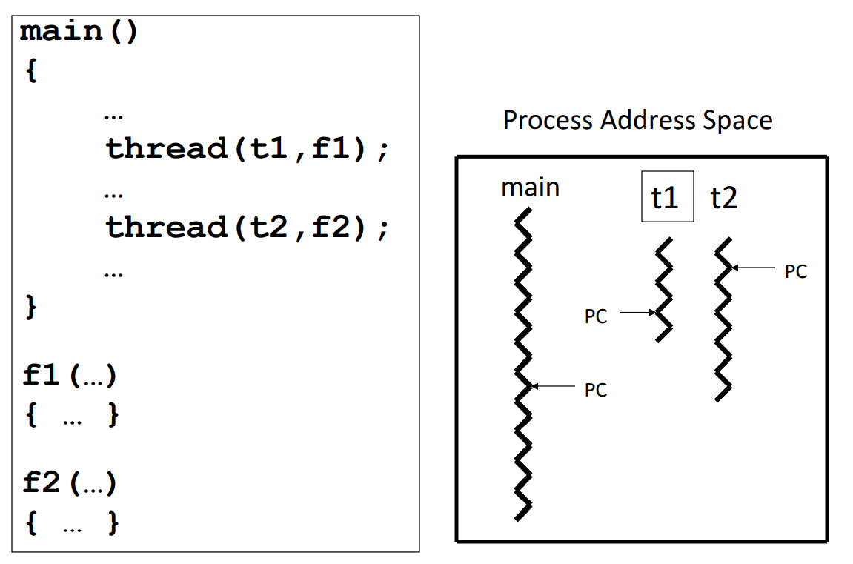
Threads
Single Threaded Process
Multithreaded Process
www.corvit.com

Slide 25
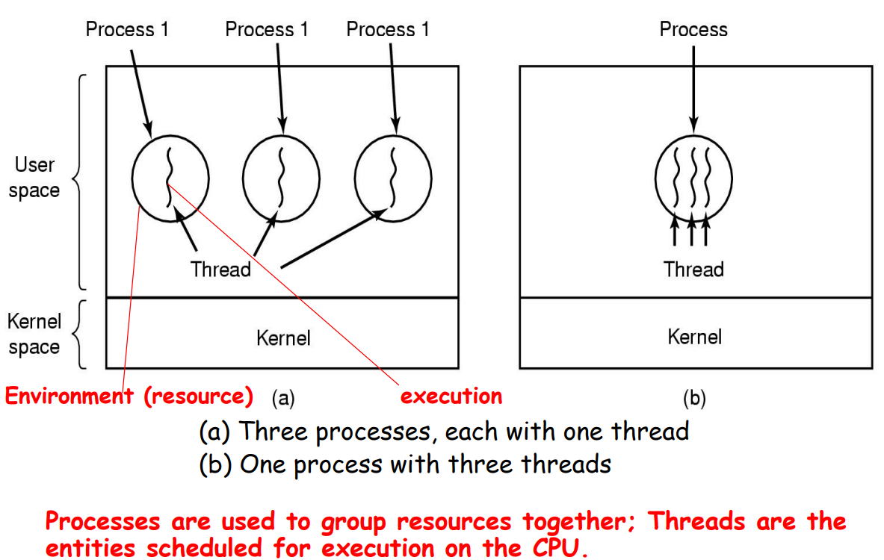
Threads
www.corvit.com

Slide 26
Threads vs Process
Similarities
Differences
A thread can also be in one of many states like new, ready, running, blocked, terminated
Like processes only one thread is in running state (single CPU)
Like processes a thread can create a child thread
No “automatic” protection mechanism is in place for threads—they are meant to help each other
Every process has its own address space, while all threads within a process operate within the same address space
www.corvit.com

Slide 27
Scheduling Algorithms
FCFS
SJF
Priority
Round Robin
www.corvit.com

Slide 28
Name some OSs
UNIX
Linux
Windows
Sun Solaris
Mac
Android
IOS
Symbian
BlackBerry
www.corvit.com

Slide 29
Linux History
UNIX
In 1969 at Bell Laboratories UNIX was deployed.
Simple and elegant.
Written in the C programming language instead of in assembly code.
Able to recycle code.
The code recycling features were very important. Until then, all commercially available computer systems were written in a code specifically developed for one system. UNIX on the other hand needed only a small piece of that special code, which is now commonly named the kernel. This kernel is the only piece of code that needs to be adapted for every specific system and forms the base of the UNIX system. The operating system and all other functions were built around this kernel and written in a higher programming language, C
www.corvit.com

Slide 30
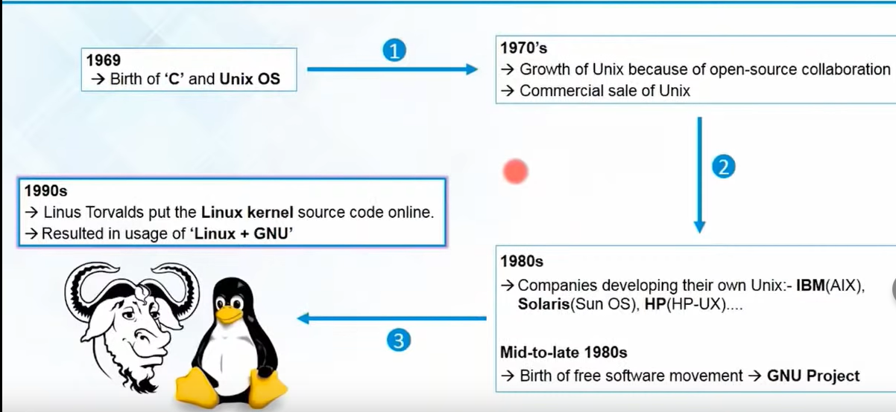
Linux History
www.corvit.com
Notes:
GNU is an extensive collection of free software, which can be used as an operating system or can be used in parts with other operating systems. The use of the completed GNU tools led to the family of operating systems popularly known as Linux.

Slide 31
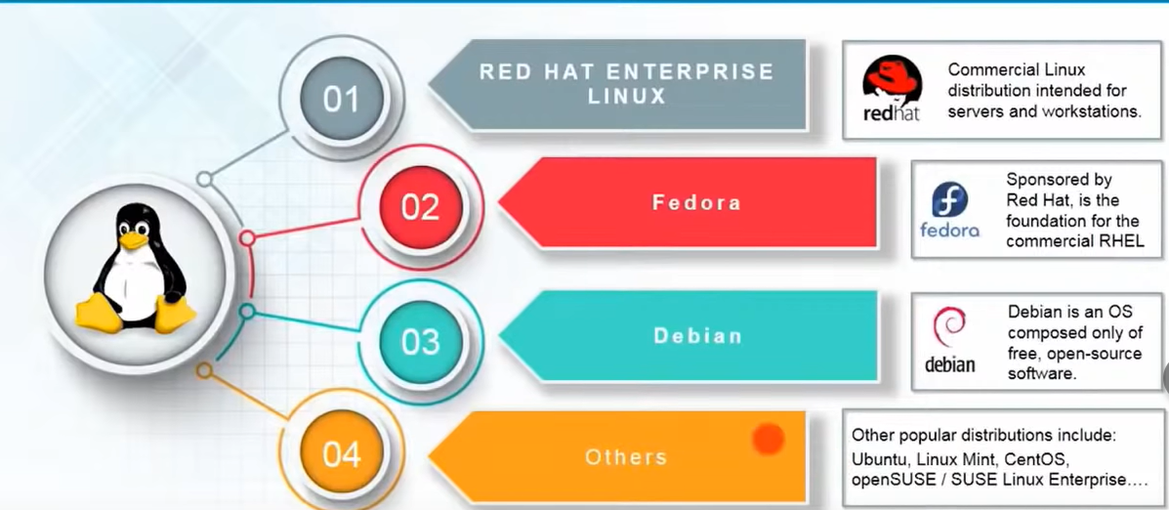
Distributions
A Linux distribution includes a kernel and a collection of applications. – Linux kernel – Applications (GNU, etc) – Desktop (Gnome, KDE, etc.)
Dozens of distributions available to suit a large variety of needs. – RedHat, SUSE, Ubuntu, CentOS, Debian
www.corvit.com

Slide 32
Pros & Cons
Pros
Cons
Open Source
Kernel is free
Linux was made to keep on running
Linux is secure and versatile
Linux is scalable
There are far too many different distributions
Linux is not very user friendly and confusing for beginners
www.corvit.com

Slide 33
Configuring Ubuntu for Lab
Install Ubuntu on your local machine as the host OS. https://ubuntu.com/tutorials/install-ubuntu-desktop#1-overview
Install Ubuntu on WSL on Windows 10 https://ubuntu.com/tutorials/install-ubuntu-on-wsl2-on-windows-10#1-overview
Install a Hypervisor (Virtual Box) on your windows machine and install Ubuntu image on the hypervisor. https://www.toptechskills.com/linux-tutorials-courses/how-to-install-ubuntu-1804-bionic-virtualbox/
www.corvit.com
Notes:
Windows Subsystem for Linux is a feature of Windows that allows developers to run a Linux environment without the need for a separate virtual machine or dual booting. There are two versions of WSL: WSL 1 and WSL 2

Slide 34
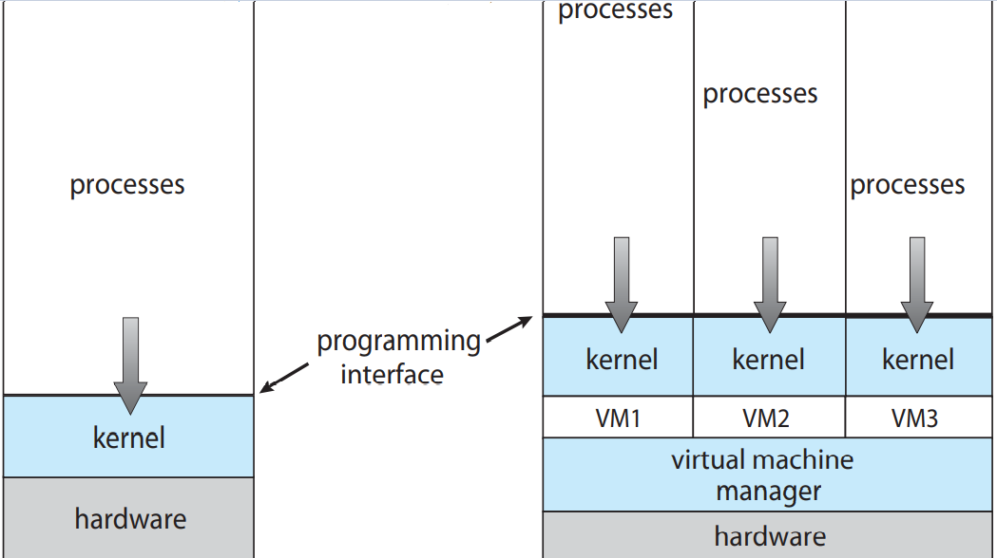
Virtualization
Virtualization is a framework or methodology of dividing the resources of a computer system into multiple execution environments
Virtualization is a Technology that transforms hardware into software
Virtualization allows to run multiple operating systems as virtual machines. Each copy of an operating system is installed in to a virtual machine.
www.corvit.com

Slide 35
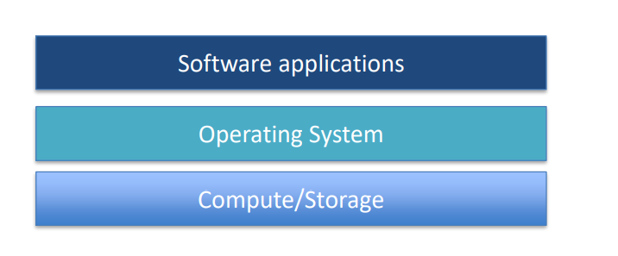
Virtualization
A stack: combination of infrastructure, OS, and applications required to support a service.
www.corvit.com

Slide 36
Virtualization Solves Problem
Servers become as easy to maintain as software.
– It’s easier to move software around than physical servers.
No need to purchase a separate server for each user or team because virtualization provides partitioning.
www.corvit.com

Slide 37
Virtualization
Host machine: physical server that supports multiple virtual machines.
Virtual machine: virtualized server instance running on a host machine (also known as an instance or a workload).
Host OS: operating system running on a bare-metal server.
Guest OS: operating system running on a virtual machine.
Hypervisor: Software that emulates and manages the communication between virtual machines and the physical server.
www.corvit.com

Slide 38
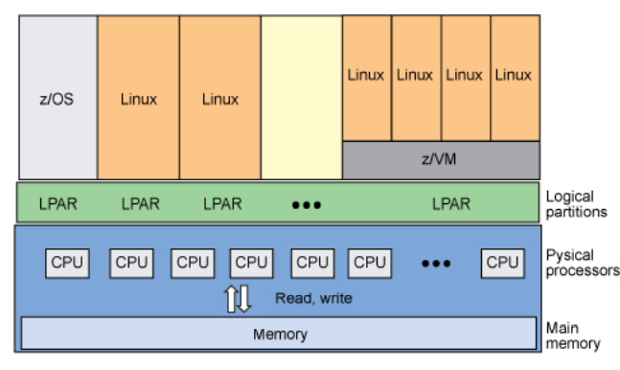
Virtualization Types
Hardware Virtualization
OS Partitioning
Part of physical server dedicated to a specific stack.
Big expensive mainframe-type systems
Host (or guest) operating system can partition out processes, memory, and scheduling to emulate a separate OS environment.
Separate OS environments all use same kernel. If host is Linux then all “guests” are Linux.
Example: Docker containers
www.corvit.com

Slide 39
Hypervisor Types
Two types available:
Type 1 Hypervisor
Runs on top of the bare-metal server and sits between hardware and operating systems in the stacks.
Examples: VMWare ESX, Microsoft Virtual Server, Xen
Type 2 Hypervisor
Runs on top of an operating system.
Easy installation (no special hypervisor or storage required).
Example: Oracle VirtualBox, VMWare Fusion
www.corvit.com

Slide 40
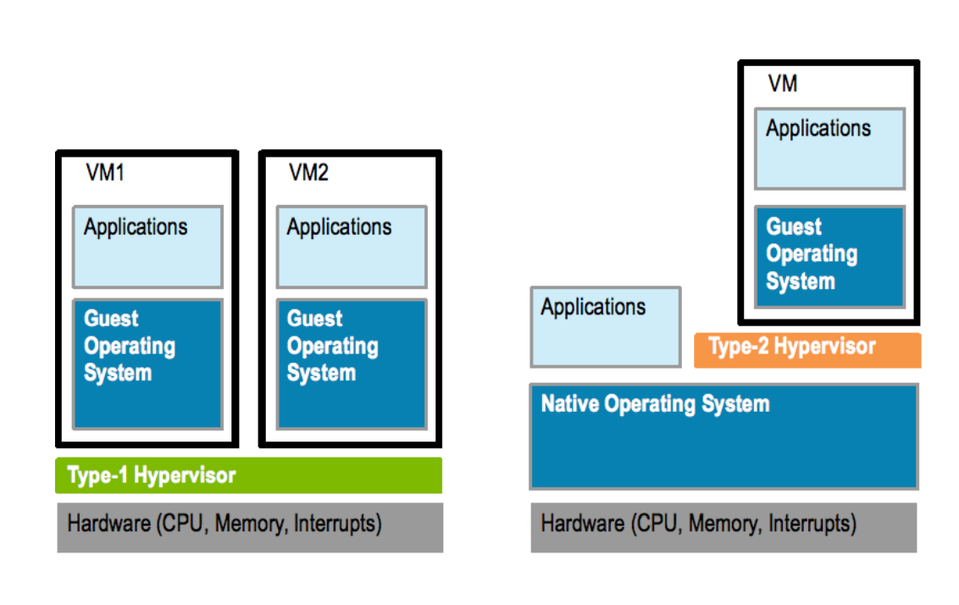
Type 1 vs Type 2 Hypervisor
www.corvit.com

Slide 41
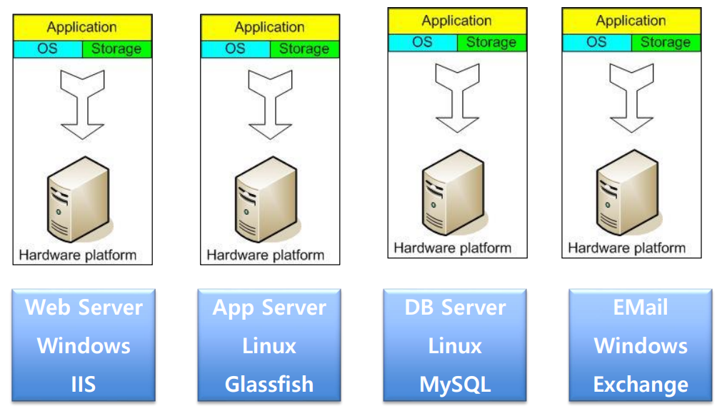
The Traditional Server Concept
www.corvit.com

Slide 42
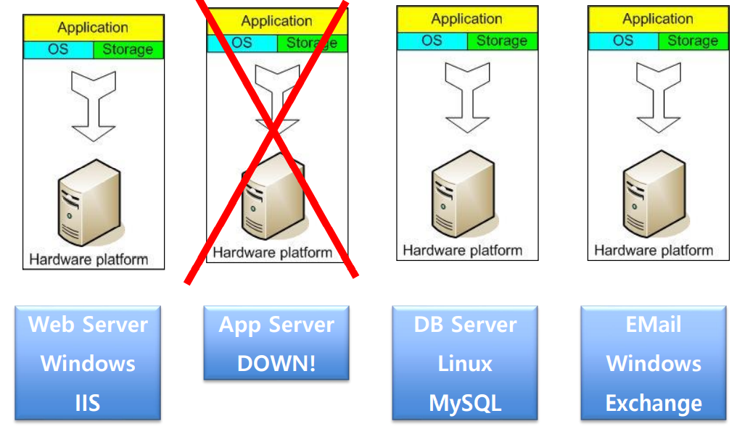
And if something goes wrong
www.corvit.com

Slide 43
The Traditional Server Concept
Pros
Cons
Easy to conceptualize
Fairly easy to deploy
Easy to backup
Virtually any application/service can be run from this type of setup
Expensive to acquire and maintain hardware
Not very scalable
Difficult to replicate
Redundancy is difficult to implement
Vulnerable to hardware outages
In many cases, processor is under-utilized
www.corvit.com

Slide 44
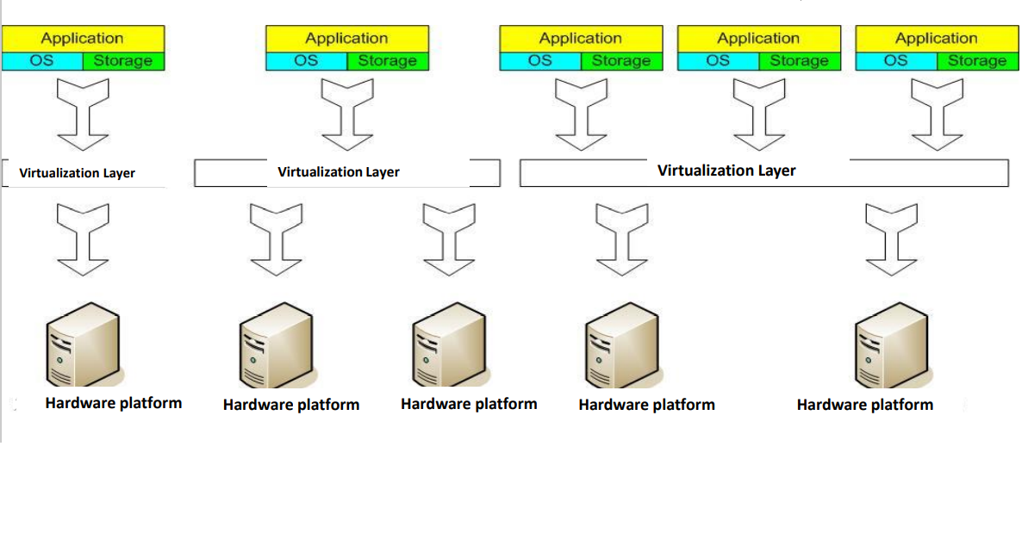
The Virtual Server Concept
www.corvit.com

